Slide 1
TEL Assessment
Rohan Bhatkande

Slide 2
Overview
Requirement
Set-up required
Data Collection
Data Cleaning
Data Insights

Slide 3
Requirement
Conda Prompt
Git Bash
Github Repository

Slide 4
Set-up Required
Build a Jupyter notebook
Connect the local to remote repo
Install required Python libraries such as pandas, matplotlib, seaborn etc

Slide 5
Data Collection
Fetch the data and save in dataframe
Dataframe has 2104 rows and 34 columns(variables)
Variables have object, integer and float datatypes

Slide 6
Data Cleaning
Check for Null values
Drop the columns with uniques values( object variables)
Convert the Timestamp to datetime datatype and make it as index
Drop variables with high correlation(>85%) and with values that make no contribution for analysis
Dataframe has 2104 rows and 17 columns(variables)

Slide 7
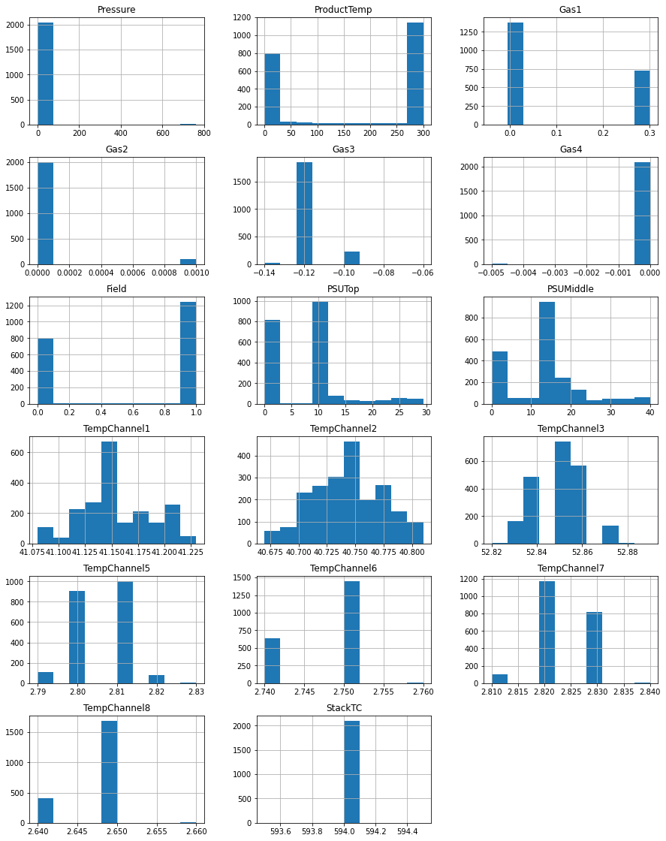
Data Insights(histogram repr. of data)

Slide 8
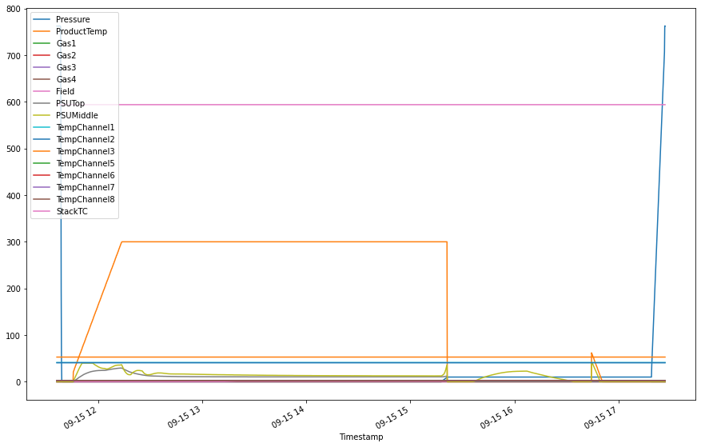
Data Insights(line plot w.r.t timestamp)

Slide 9
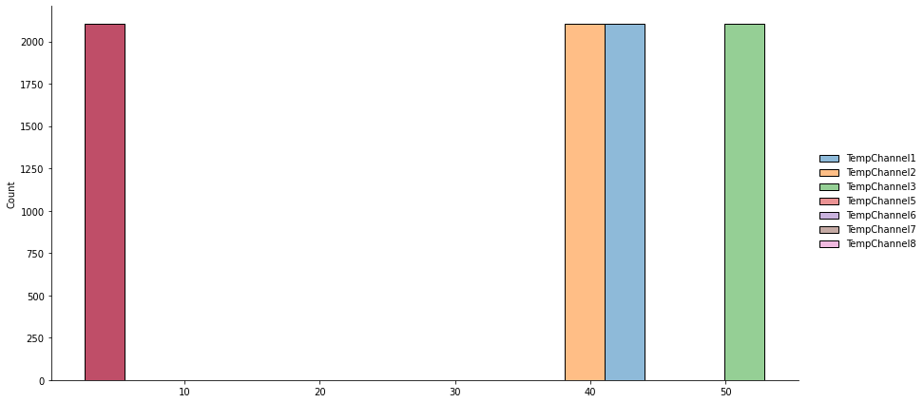
Data Insights(dist. plot of Tempchannel)

Slide 10
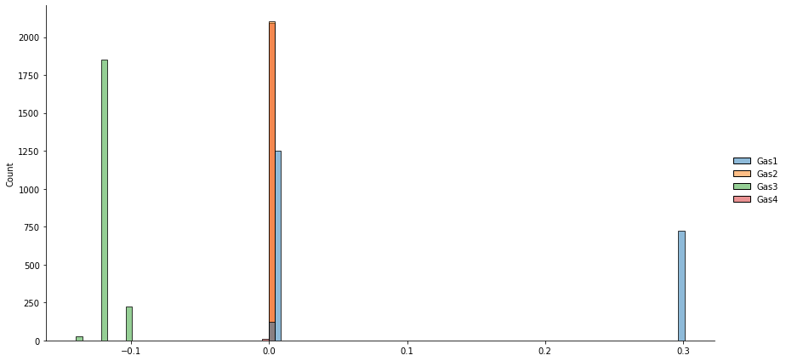
Data Insights(dist. plot of Gas and PSU)

Slide 11
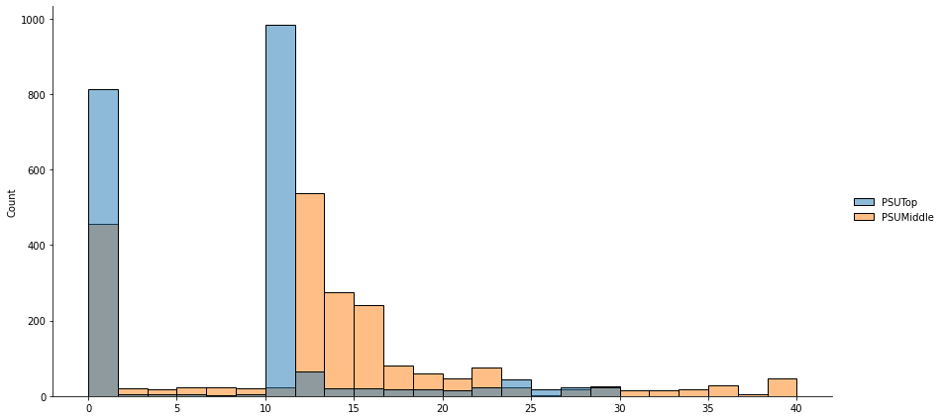
Data Insights

Slide 12
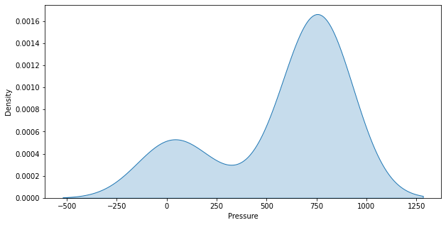
Data Insights(kde plot for Pressure)

Slide 13
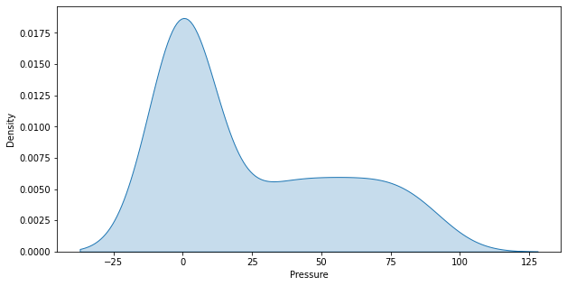
Data Insights(kde plot for ProdTemp)

Slide 14
Thank you

